Slide 1
Programming Languages

Slide 2
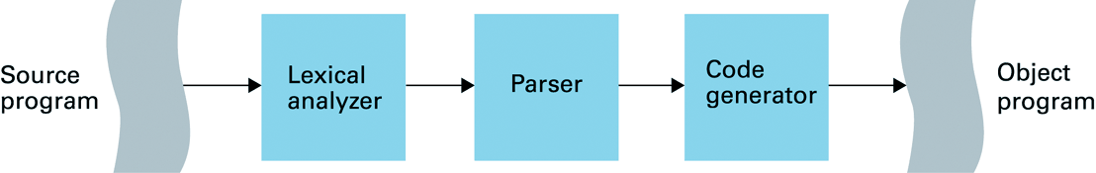
What is “Programming”
Writing source code and turning it into a sequence of machine language instructions that the computer can execute.

Slide 3
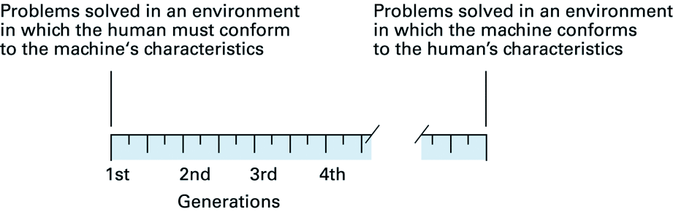
“Generations” of Programming Languages

Slide 4
“Generations” of Programming Languages
First Generation
Machine language (Binary)
Second Generation
Assembly language (CISC and RISC)
Third Generation
“High-level” languages such as Pascal, C, COBOL, Fortran
Fourth Generation
Scripting languages such as SQL, Applescript, VBScript
Fifth Generation?
Natural language? Automatic code generation? Object-oriented languages?

Slide 5
Four types of programming languages
Functional
Lisp, ML, Scheme
Good for evaluating expressions.
Declarative
Prolog
Good for making logical inferences.
Imperative
C, Pascal, Fortran, COBOL
Good at performing calculations, implementing algorithms.
Object-oriented
C++, Java, C#, Visual Basic
Much like imperative languages, but have support for
“communication” among objects.

Slide 6
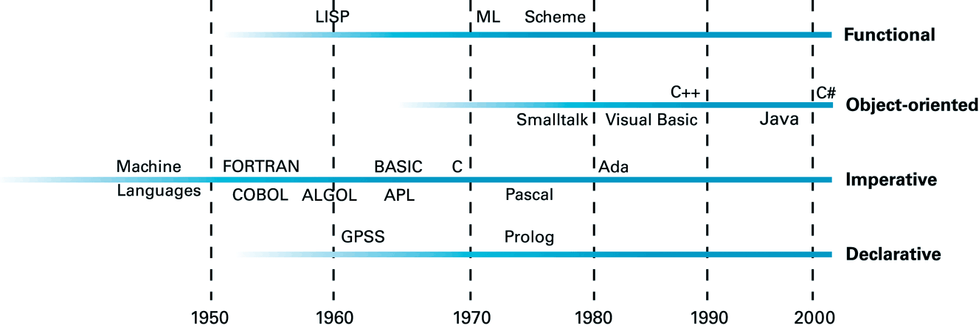
History of Programming Languages

Slide 7
Integrated Development Environments
Source-code editor
Source-code management
Compiler
Interactive debugger

Slide 8
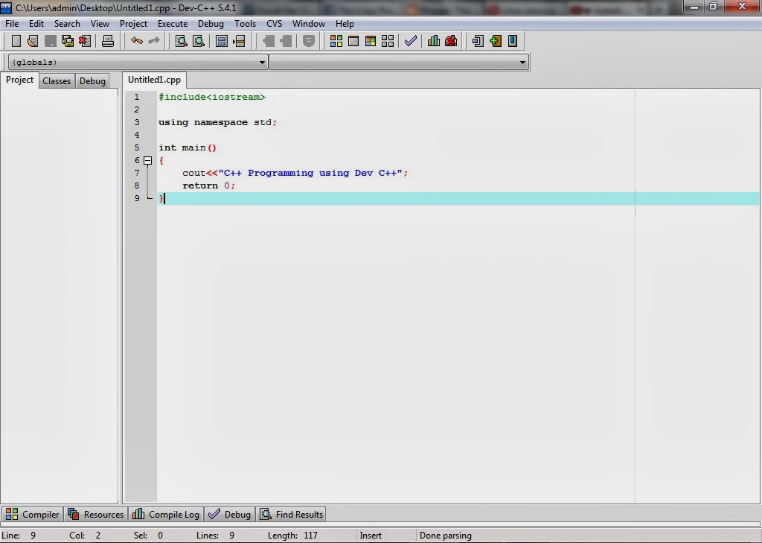
Dev C++ IDE

Slide 9
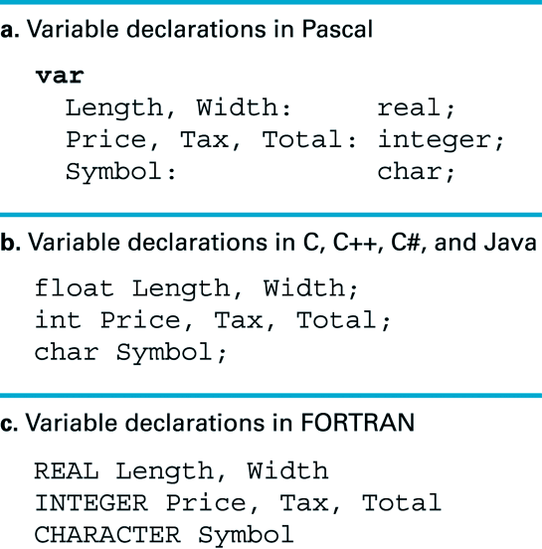
“Variables”

Slide 10
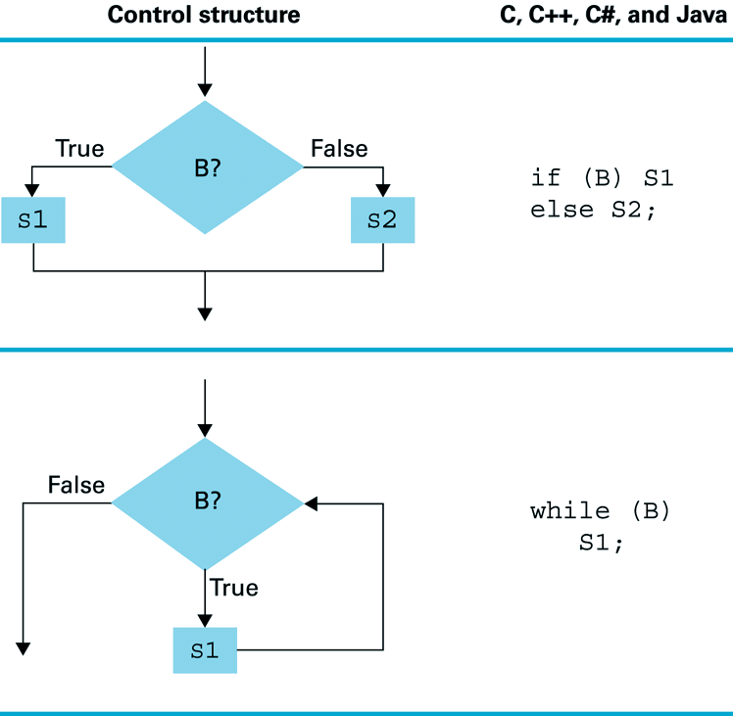
While loop control structure

Slide 11
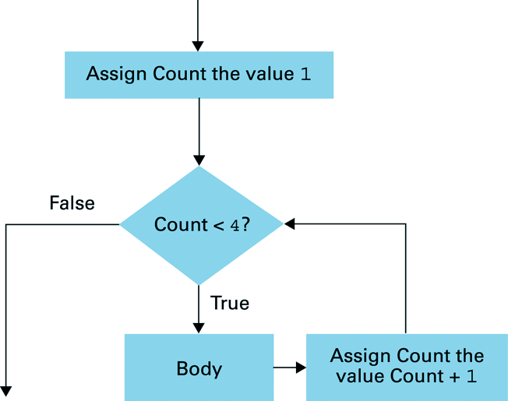
For-loop control structure

Slide 12
If conditional control structure

Slide 13
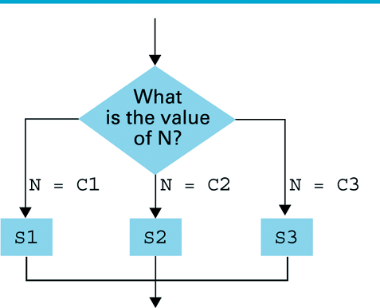
Case conditional control structure

Slide 14
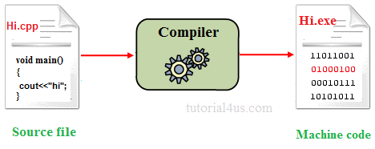
Compiler

Slide 15
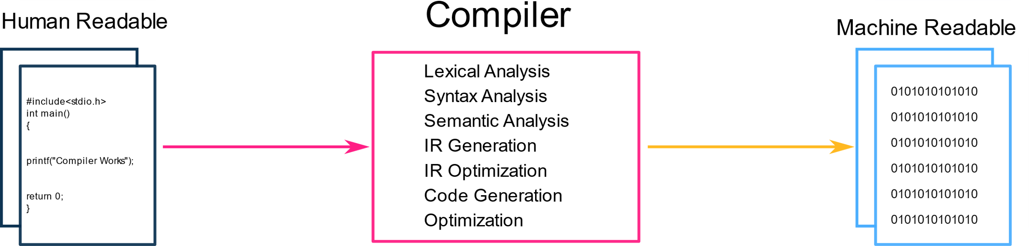
Stages Of Compiler

Slide 16
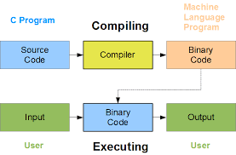
How Does A Program Work?

Slide 17
Thanks For Viewing The Presentation
Sources : Various Sites
Like
*.edu
Google
Wikipedia

